Slide 1
ACTIVITIES OF DAILY LIVING DETECTION USING SMART MICROPHONES
ATHULYA SHAJI (B00873604)
MSC COMPUTER SCIENCE
SCHOOL OF COMPUTING
ULSTER UNIVERSITY BELFAST

Slide 2

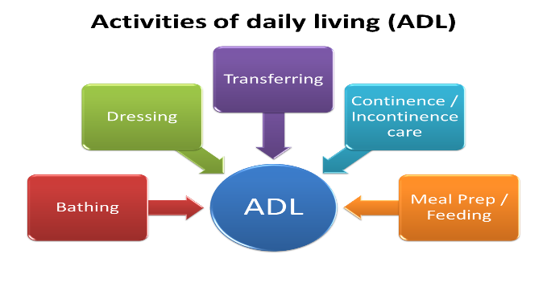
INTRODUCTION
A study from 2019, shows 1,097 (19.8%) out of 5,540 developed ADL impairment between 50 and 64 years [1].
People with ADL impairment had an increased risk of hospitalization, nursing home admission, and death.
Incapability to do those elementary tasks leads to unsafe living conditions and calls for assistance.
Basic ADLS [2]

Slide 3
PROBLEM STATEMENT
Identify the basic ADL sounds from a household using an AI model thereby helping to track an individual’s living condition with minimal human interference or assistance.
Incorporate a semi-automated annotation technique into the system for a further continuous learning model.

Slide 4
PREVIOUS WORK
Sensor-Based Systems: Wearable sensors like accelerometers and gyroscopes used for ADL detection
Smart Homes: ADL detection via environmental sensors installed in smart homes
Computer Vision: Image processing techniques applied to recognize ADLs
Machine Learning & AI: Application of deep learning techniques, particularly convolutional and LSTM networks, for recognizing ADLs from sensor data
Data Fusion: Combining data from multiple sources for enhanced ADL detection

Slide 5
AUDIO CLASSIFIER DESIGN PROCESS
Access & Create Data
Preprocess & Explore Data
Develop Predictive Model
Deploy & Share

Slide 6
METHODOLOGY

Slide 7
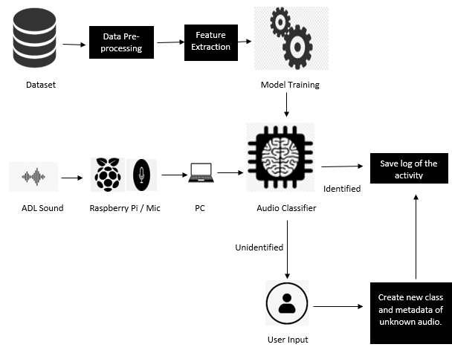
ARCHITECTURE

Slide 8
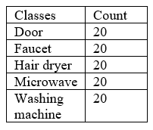
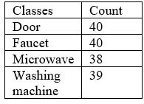
DATASET
Audio data were downloaded from an open-source website Pixabay

Slide 9
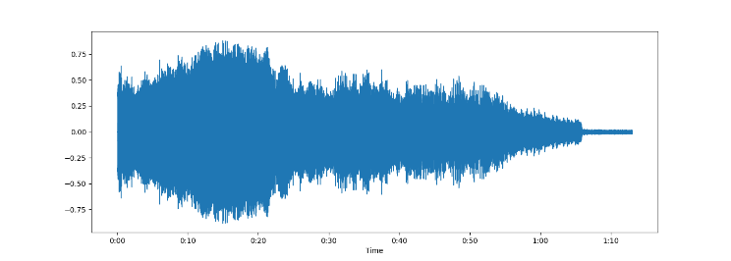
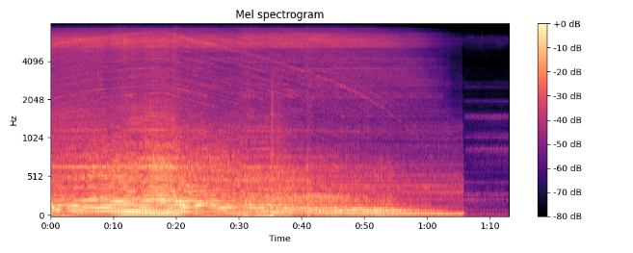
DATA PREPROCESSING & FEATURE EXTRACTION
MP3 to WAV conversion
Metadata creation
Data and sample rate
Waveform representation of a 1.12-minute-long microwave audio signal.
Mel-Frequency Cepstral Coefficients (MFCCs)
Spectrogram of a 1.12-minute-long microwave audio signal

Slide 10
MODEL TRAINING
MFCC | ANN | SVM | Decision tree | KNN | NB | Perceptron
40 | 50 | 78 | 60 | 70 | 68 | 61
20 | 55 | 78 | 80 | 70 | 65 | 53
Accuracy (%) of six MLCs trained on five classes with 20 samples each
Accuracy (%) of six MLCs trained on four classes with 40 (approx.) samples each
MFCC | ANN | SVM | Decision tree | KNN | NB | Perceptron
40 | 43 | 75 | 66 | 68 | 72 | 65
20 | 50 | 72 | 62 | 68 | 71 | 62

Slide 11
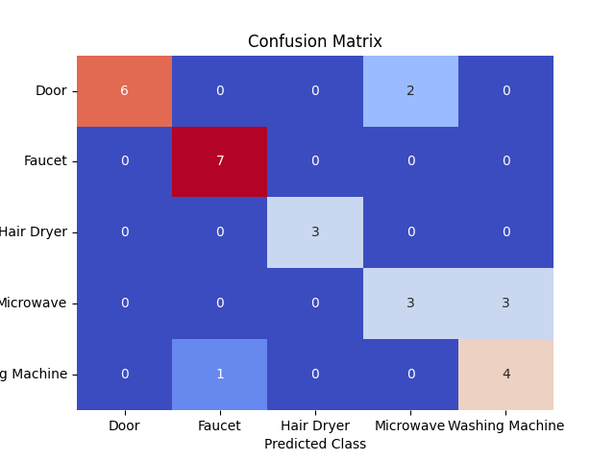
AUDIO CLASSIFIER : SVM
Dataset | 4 classes 40 samples |  | 5 classes 20 samples
MFCC | Mean CV (%) | Accuracy (%) | Mean CV (%) | Accuracy (%)
40 | 74 | 62 | 71 | 79
20 | 66 | 60 | 78 | 79
Training results of SVM on 70:30 train: test ratio

Slide 12
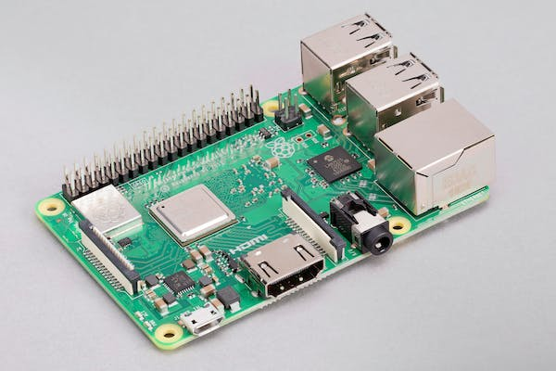
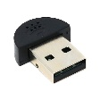
REAL-TIME ADL CAPTURE
VNC Viewer
SSH client (Putty)
Raspberry Pi 3 model b+ [3]
USB Microphone [4]

Slide 13
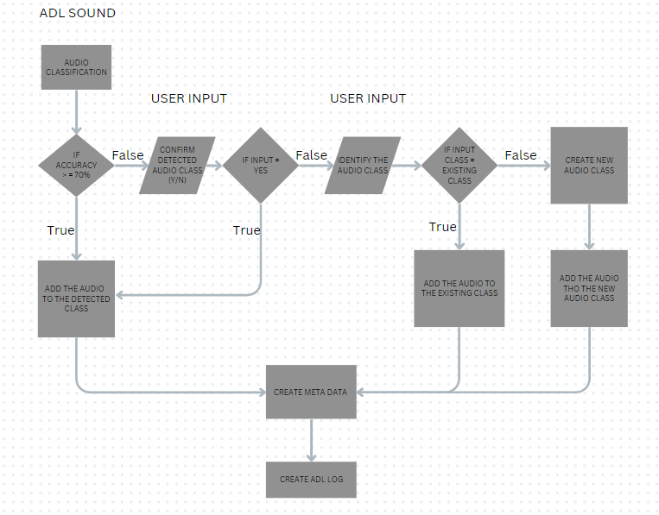
ADL DETECTION, ANNOTATION, AND LOGGING

Slide 14
CONCLUSION
An SVM audio classifier with an expanding dataset has been designed and implemented to detect ADL sounds and maintain its log.
The system works on a semi-automated annotation method with user input in text format
Challenges :
Availability of data
Raspberry Pi and Eduroam compatibility
Raspberry Pi and Python library compatibility
Raspberry Pi and MATRIX integration
Future Scope :
Integrating the MATRIX Voice
Automate audio recording and transfer
Improved User Interface (UI)
ADL log analysis
Automate Audio classifier retraining

Slide 15
ACKNOWLEDGMENT
Dr Matias Garcia-Constantino
Dr Ian Cleland
Dr Shuai Zhang

Slide 16
REFERENCE
[1] Brown, R. T. et al. (2019) ‘Association of functional impairment in middle age with hospitalization, nursing home admission, and death’, JAMA internal medicine, 179(5), pp. 668– 675.doi:10.1001/jamainternmed.2019.0008.
[2] Redirect notice (no date) Google.com. Available at: https://www.google.com/url?sa=i&url=https%3A%2F%2Fltcga.co m%2Flong-term-care-guide-activities-of-dailyliving%2F&psig=AOvVaw37QBacEzWByPx9YRG5qYfS&ust=1 683637561856000&source=images&cd=vfe&ved=0CBAQjRxqF
woTCJjBqezk5f4CFQAAAAAdAAAAABAE (Accessed: 8 May 2023).
[3] (No date b) Prismic.io. Available at: https://images.prismic.io/rpf-products/bef8cda3-64ea-4098-bf188e731a6e9a0d_3b%2B%20Angle%202.jpg?ixlib=gatsbyFP&auto=compress%2Cformat&fit=max&w=799&h=533 (Accessed: 11 May 2023).
[4] (No date d) Shopify.com. Available at: https://cdn.shopify.com/s/files/1/0176/3274/products/mini-usb-microphone-the-pi-hut-10286533678856618179_grande.jpg?v=1646920627 (Accessed: 11 May 2023).

Slide 17
THANK YOU

